Slide 1
SSD: Single Shot MultiBox Detector

Slide 16
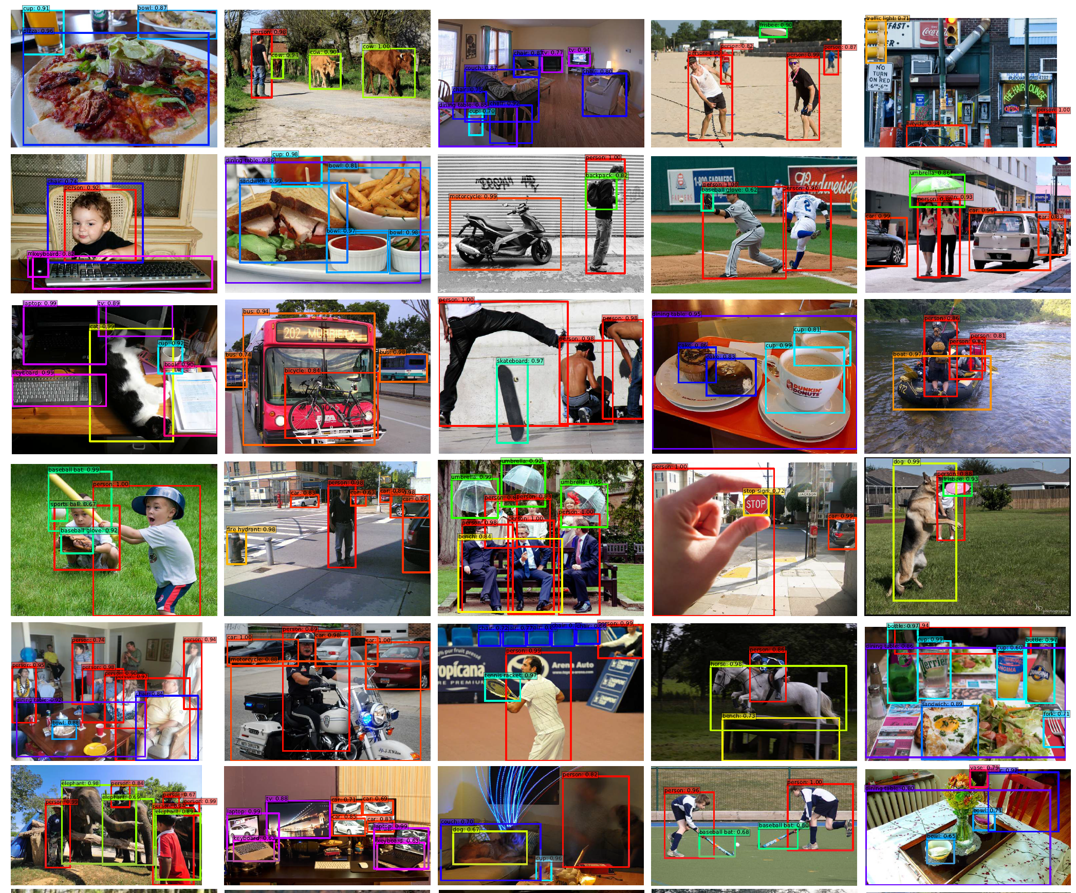
Results

